Slide 1
Section 6.2 Solving Equations by Using Scales
©Copyright All Rights Reserved to Homework Depot at www.BCMath.ca

Slide 2
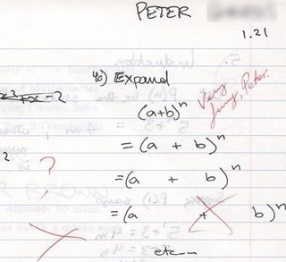
©Copyright All Rights Reserved to Homework Depot at www.BCMath.ca

Slide 3
Balancing Equating with Scales:
When there is an “equal” sign, it indicates that both sides of the equation are equal
If we add values only to one side, the scale will tip and not equal
Rule: Whatever we do to isolate “x” on one side, we must do the same operation to the other side
To solve the equation we need to isolate “x” by taking out the same values from both sides
Divide both sides by 3 because “x” is multiplied by 3
Subtract 4 from both sides because there’s a plus 4 on the right
So “X” is equal to 3.5
©Copyright All Rights Reserved to Homework Depot at www.BCMath.ca

Slide 4
Ex: How much does One star cost?
Ex: Record all your steps
1. Remove one star from sides
1
1
1
1
1
2. Subtract two coins from sides
1
1
1
3. Divide each side into two groups
4. Now there’s only one star on the left side and two coins on the right side
1
1
Therefore one star is equal to 2 coins
©Copyright All Rights Reserved to Homework Depot at www.BCMath.ca

Slide 5
Practice: Solve the following equations for “x”
The goal of this question is to find out how much little boxes one yellow stick is equal to
Add “x” to both sides
Add 2 to both sides
Divide each
side into 4 groups
Subtract “x”
from both sides
Add 3
Divide each side into 4 groups
Divide each side by -1
Flip the colour on each side
©Copyright All Rights Reserved to Homework Depot at www.BCMath.ca

Slide 6
Practice: Solve Each equation & Verify the solution:
Subtract 10 from both sides
Add 4.5 to both sides
Multiply by-2
Multiply by 3
Divide by 3
Divide by 4
There are 2 ways to do this question
Expand the right side
Divide by-2
Subtract 6 from both sides
Add 3 to both sides
Divide both sides by 2
Divide by -1
©Copyright All Rights Reserved to Homework Depot at www.BCMath.ca

Slide 7
Ex: A taxi ride costs $5 for the base cost and then $0.45 per minute. If a taxi ride costs $15.35, how long was the ride? Write an equation to solve the problem
Let the variable “C” represent the cost
Let the variable “T” represent the number of minutes
The ride was 23 minutes long
Formula:
©Copyright All Rights Reserved to Homework Depot at www.BCMath.ca

Slide 8
Practice: Solve the following equations for “x”
©Copyright All Rights Reserved to Homework Depot at www.BCMath.ca

Slide 9
Homework:
P281 # 7, 10, 14, 17, 19 , 20
©Copyright All Rights Reserved to Homework Depot at www.BCMath.ca

Slide 10
©Copyright All Rights Reserved to Homework Depot at www.BCMath.ca

